Slide 1





OLYMPIC DATA ANALYSIS
CAPSTONE PROJECT-INTERNSHIP 1
DATA DYNAMOS
ARSHDEEP SINGH
MADHUSHREE.S
PASAM NUTAN
CSE - AIDE(4TH SEM)

Slide 2

Pipeline
01
02
Introduction
03
Dataset
Agenda
05
Insights and findings
06
Conclusion
04
Problem Statement and the purpose

Slide 3
Agenda for Analysis
Descriptive
Analysis
Univariate and Bivariate Analysis
Multivariate analysis
Demographic and temporal
Analysis
Geospatial and Predictive analysis

Slide 4


Introduction
Our analysis delves into the Olympic Athlete dataset alongside the National Olympic Committee (NOC) regions.
Through advanced analytics and visualization, we aim to unveil global sporting trends and regional dynamics.
Join us as we explore this rich dataset to inform strategic decisions in sports management and policy formulation.

Slide 5
Dataset Inspection
Name: Olympic Dataset
Features include:
Name
Weight
Sex
Team
Height
NOC
Games
City
Year
Sport
Season
Event
Medal

Slide 6
."
."
Lack of strategic considerations for future games."
Lack of strategic considerations for future games."
 | Limited insights into evolving trends.
 | Unclear understanding of athlete performance determinants
Problem STATEMENT
Despite the immense popularity and historical significance of the Olympic Games, there remains a need to comprehensively understand and analyze various aspects of this global sporting event.
Lack of strategic considerations
for future games.

Slide 7

Purpose of the Analysis
The objective of this Olympic data analysis is to
uncover valuable insights that can inform
athlete training programs,
enhance performance strategies,
promote equitable participation,
and contribute to a deeper understanding of the dynamics of the Olympic Games.
By examining this data, we aim to identify trends, patterns, and factors that influence athlete performance and success, thereby providing valuable information for
athletes,
coaches,
sports organizations,
policymakers, and researchers.

Slide 8
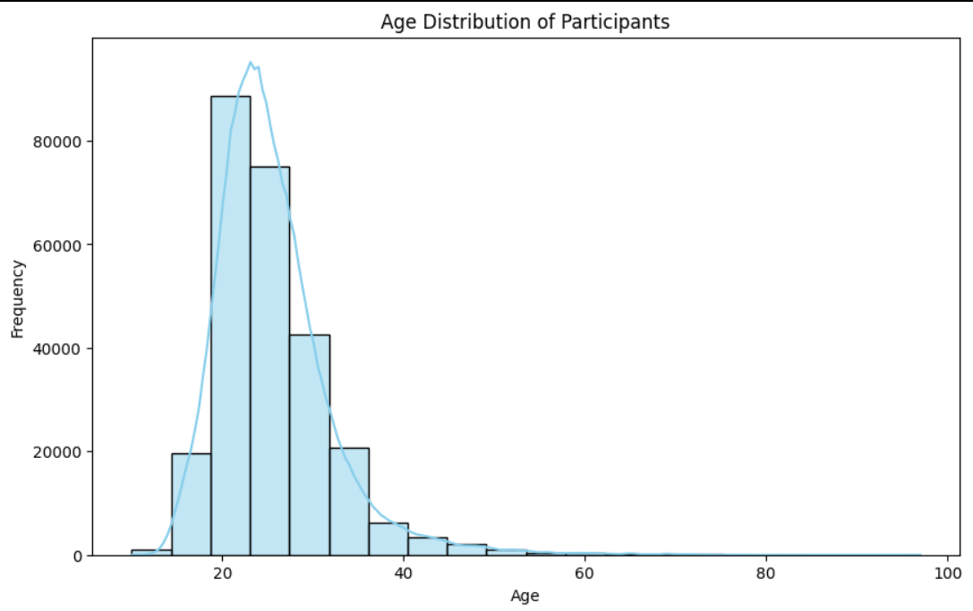
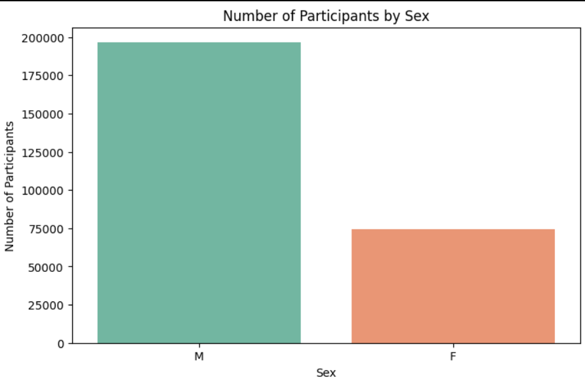
Insights and Findings(Participant count)
Age Distribution of participants
Number of participants by sex
Max no of participants in the age 23 -21875
Min no of participants in the age 97 - 1
Male(maximum) participants -196594
Female - 74522le participants - 74522

Slide 9
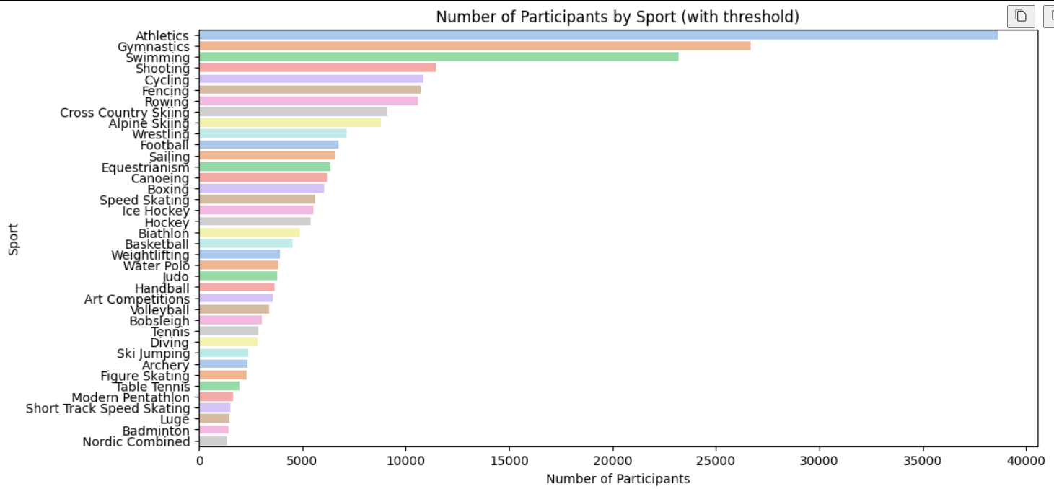
Insights and Findings(Participant count)
Sport Distribution of participants
Number of participants by sport:
Athletics 38624 Gymnastics 26707 Swimming 23195 Shooting 11448 Cycling 10859 Racquets 12
Jeu De Paume 11
Roque 4
Basque Pelota 2 Aeronautics 1
More participation in summer Olympics than winter olympics
participants - 74522

Slide 10
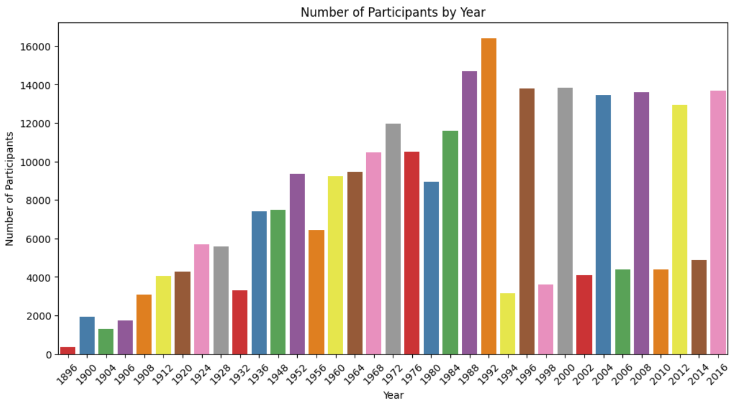
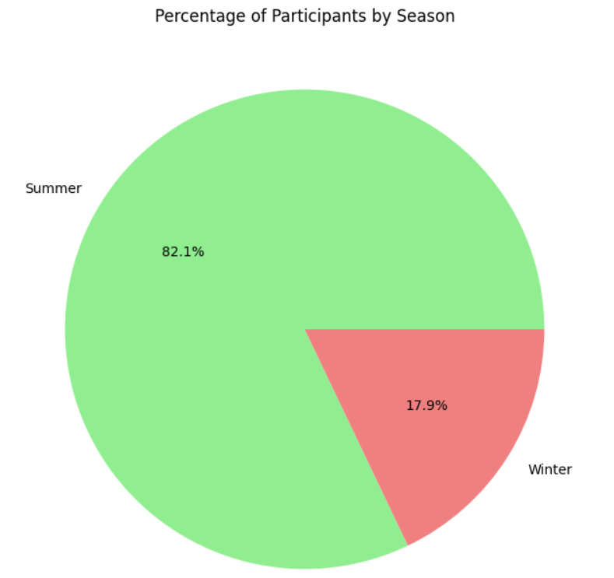
Insights and Findings(Participant count)
Number of participants by year
Number of participants by season
Max participants year : 1992 followed by 1988
Least participants year: 1896
More participation in summer Olympics than winter olympics

Slide 11
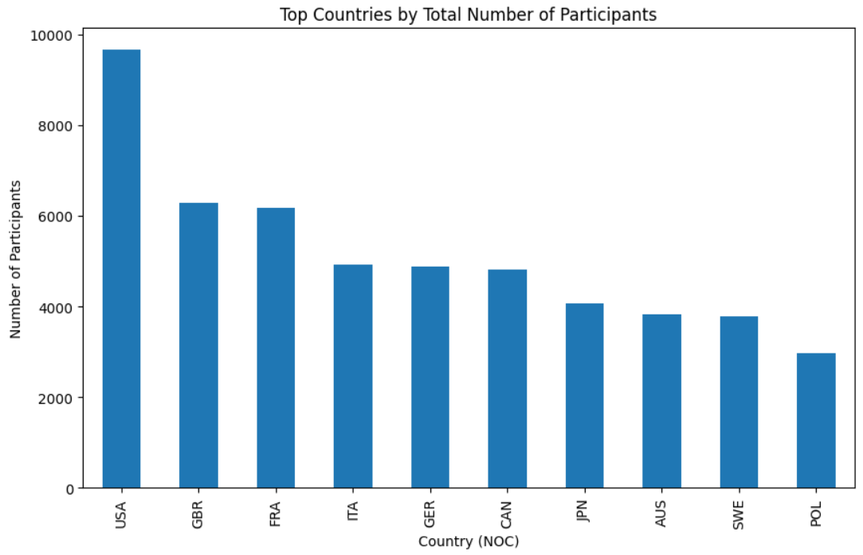
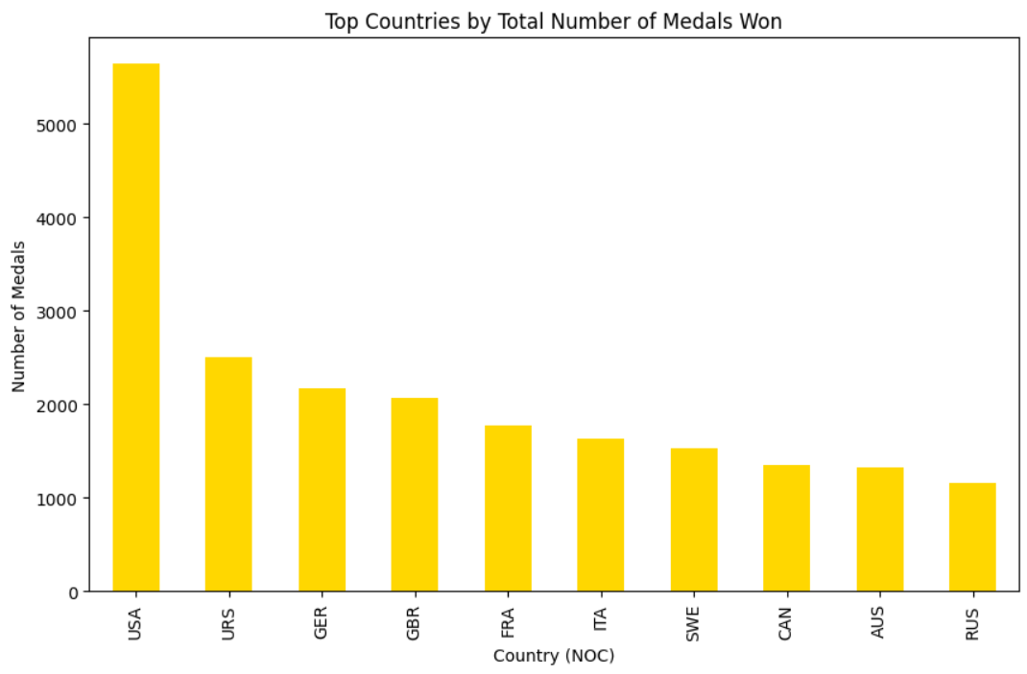
Insights and Findings(Univariate Analysis)
Highest : USA
Followed by:
GBR 6281
FRA 6170
ITA 4935
GER 4872
CAN 4811
JPN 4067
AUS 3820
SWE 3787
POL 2970
Top 10 countries with highest
number of medals won
Highest number of medals won: USA
Followed by:
URS 2503 GER 2165 GBR 2068 FRA 1777 ITA 1637 SWE 1536 CAN 1352 AUS 1320 RUS 1165
Top 10 countries with highest number of participants

Slide 12
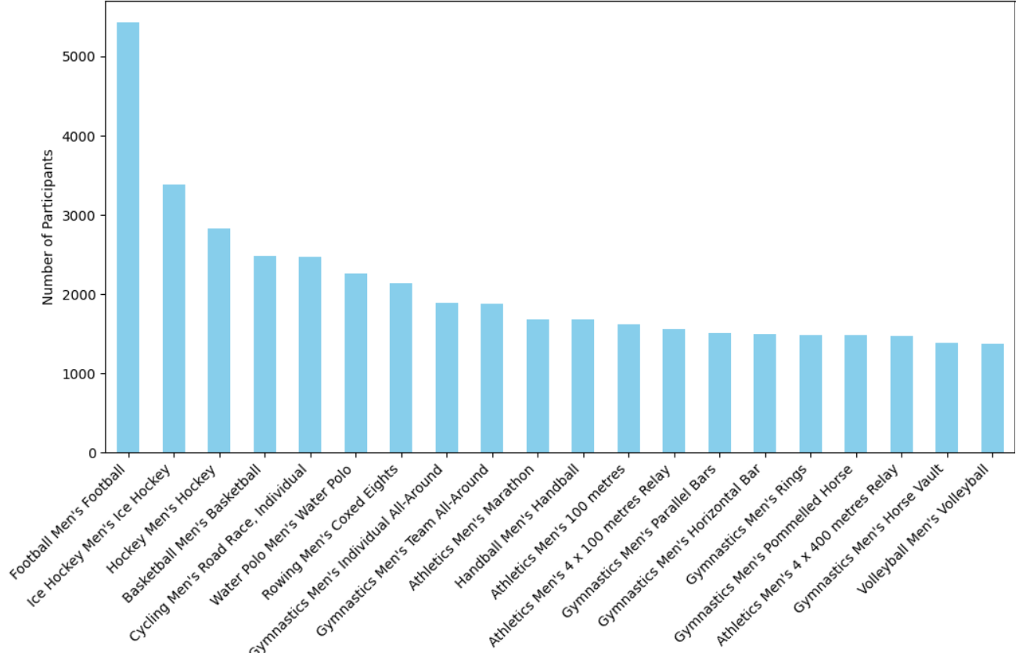
Insights and Findings(Univariate Analysis)
Top 20 Events with the highest number of participants
Top 20 Highest no of participants
Highest : Football Men’s Football
Followed by:
Men’s ice hockey
Men’s hockey
Men’s basketball etc

Slide 13
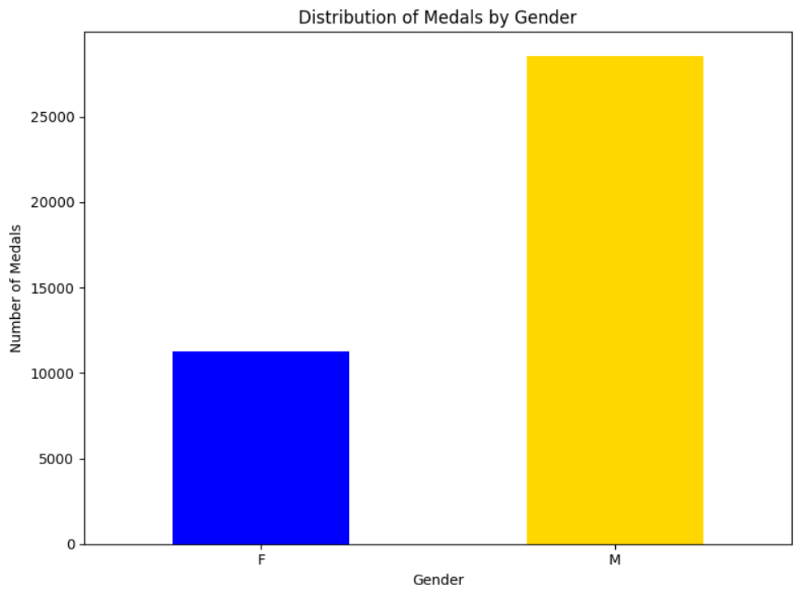


Insights and Findings(Participant count)
Medal tally by gender
Highest : male(more than 25k)
Female : around 11 to 12k

Slide 14
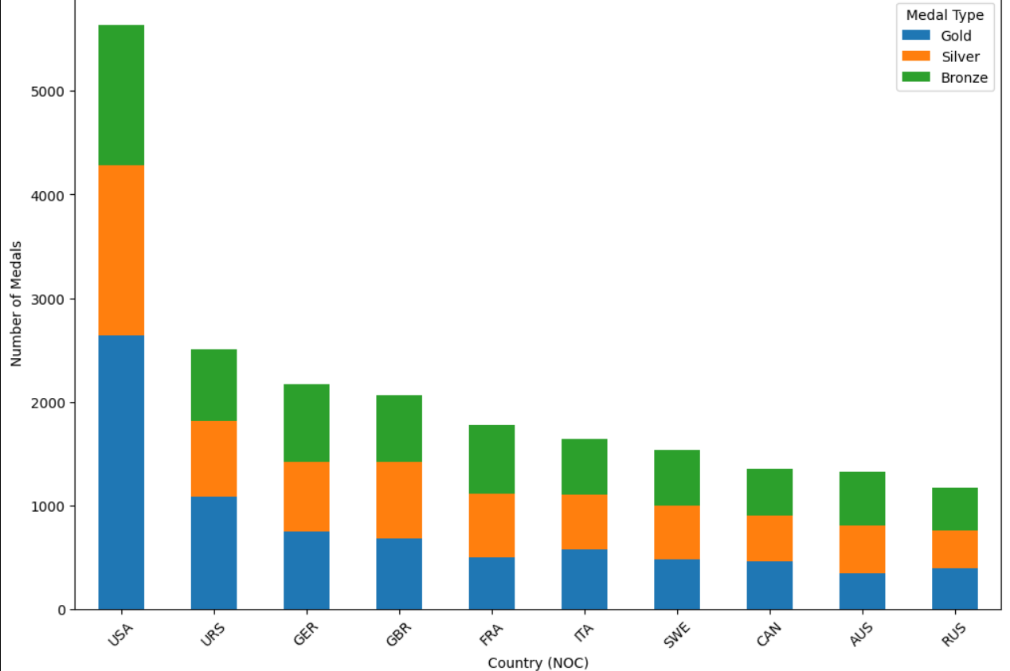
Insights and Findings(Bivariate and Analysis)
Top 10 countries based on the number ff medals
Top 10 countries based on the number of medals
Highest: USA
Followed by
URS
GER
GBR
Etc
This shows the dominant countries in olympics

Slide 15
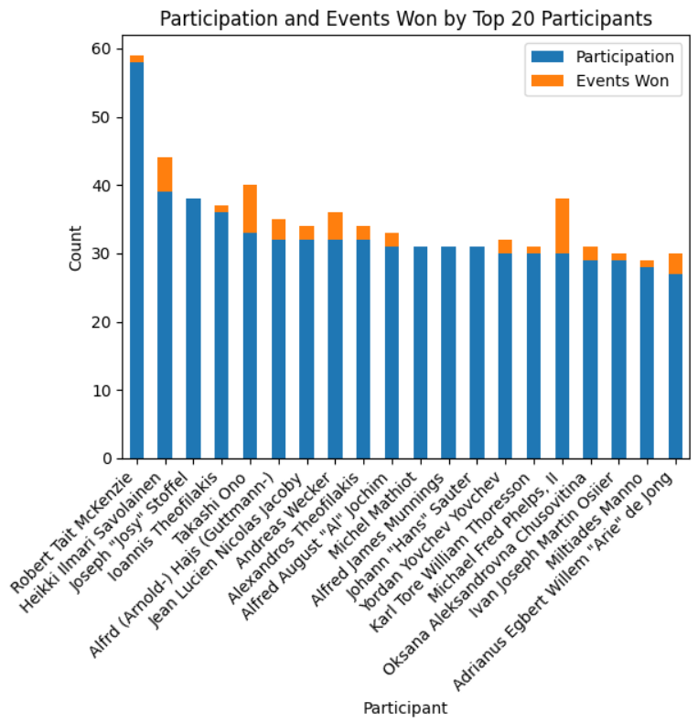
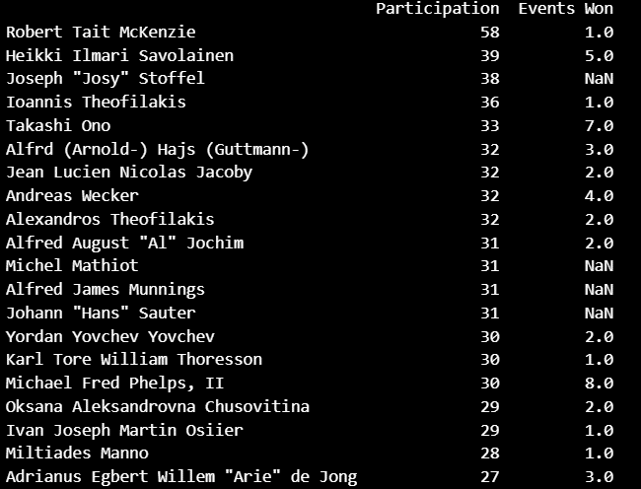
Insights and Findings(Multivariate Analysis)
Participation and events won by top 20 participants

Slide 16
CHALLENGES FACED AND HOW WE HANDLE IT?
Data Preprocessing: Dealing with missing values, duplicates, and inconsistencies in the dataset posed a significant challenge during the initial stages of analysis. Ensuring data quality and integrity was crucial for accurate insights and predictions.
Predictive Analysis: Achieving improved model performance in predictive analysis required overcoming various challenges such as selecting appropriate features, handling imbalanced datasets, optimizing model hyperparameters, and enhancing the overall predictive accuracy.
Data Integration: Integrating diverse datasets from different sources with varying formats and structures was a complex task. Ensuring seamless integration while maintaining data consistency and integrity was essential for generating comprehensive insights.

Slide 17
Insights and Findings(Participant count)
Medal tally by gender
Highest : male(more than 25k)
Female : around 11 to 12k

Slide 18

CONCLUSION
"In conclusion, our analysis has shed light on key trends, challenges, and opportunities within the Olympic dataset. By leveraging data-driven insights, we can enhance strategic planning and athlete performance.
Moving forward, a commitment to overcoming challenges, embracing effective visualization, and continuous learning will be paramount for driving impactful decision-making in Olympic management."

Slide 19
Thank you!
FEEDBACK IS APPRECIATED

